Slide 1
Phishing URL Detection
Detecting & Blocking Malicious Websites
Group 11:
Anujot Singh
Ashutosh Ojha
Ilisha Aggarwal
Subhadra Rangaswamy

Slide 2

Introduction
Act of duplicity.
Acquire sensitive information that can harm the victim.
According to the FBI, phishing is the most common type of cybercrime.
74% of U.S. organizations experienced a successful phishing attack in 2020:
4% increase from 2019.
12 times more phishing attacks than in 2016.
pandemic drove up cybercrime by 600%!

Slide 3
Motivation
Different ML Algorithms help us to classify non-phishing websites from phishing ones.
Implementation of classification algorithm and techniques to extract the phishing data sets criteria to classify their legitimacy.
Websites can be detected based on some important characteristics like URL and Domain Identity, and security etc.
According to the researchers’ experiments, the model reached 94% accuracy in detecting phishing websites.

Slide 4
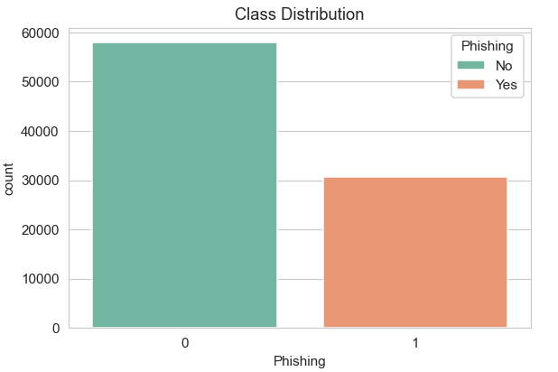
Dataset
Nearly 88k datapoints, 58k legitimate, 30k phishing.
Each website is represented by the set of 111 features which denote, whether website is legitimate or not.
The repository had two variants of Phishing Data set.
In both the variants, 0 labeled websites are legitimate & 1 labeled websites are Phishing.

Slide 5
Our Approach
Pre-processing
Four major phases:
Data Cleaning & Pre-processing
Model Selection
Hyperparameter Tuning
Final Modelling
Model Selection
Optimization
Final Train & Test

Slide 6
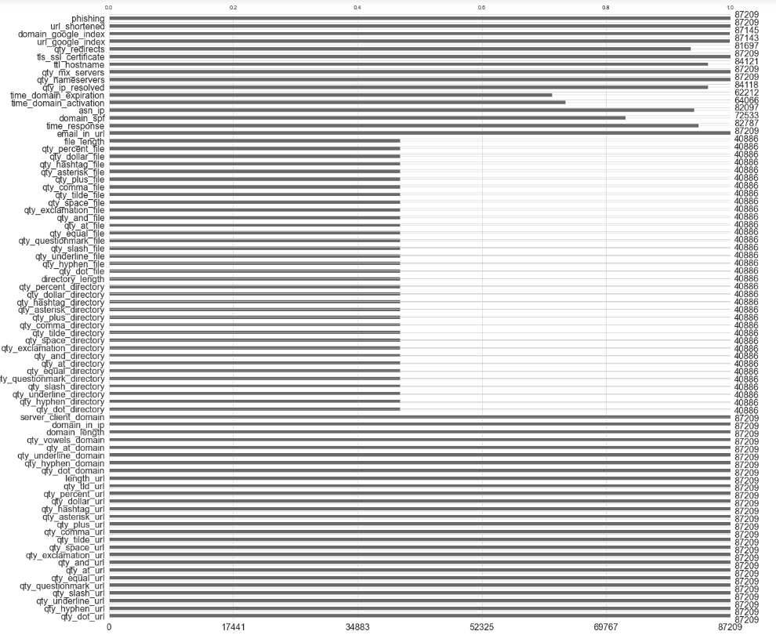
Data Cleaning & Pre-processing
Dropping duplicates
Dropping single value columns
Handling -1 values:
Consider -1 as valid
Consider -1 as invalid
kNN imputation
Mean imputation
3 different dataset instances

Slide 7

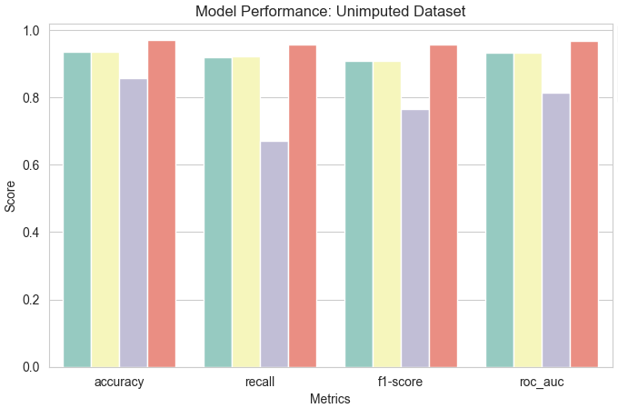
Model Selection
Train-Validation-Test split
60:20:20
4 models:
Logistic Regression
Linear SVM
Naive Bayes
XGBoost
3 dataset representations
12 model + dataset combinations

Slide 8
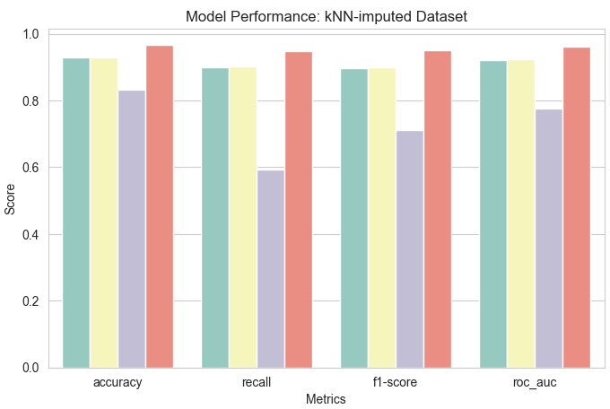
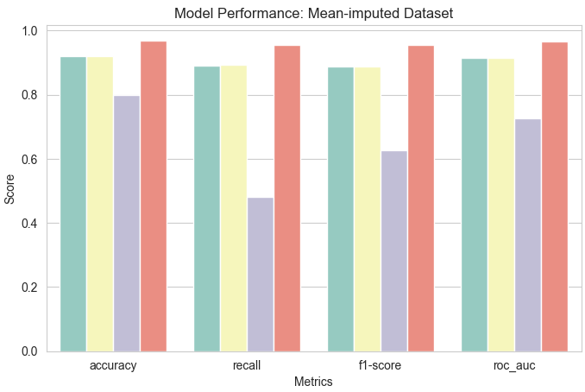
Model Selection: Results

Slide 9
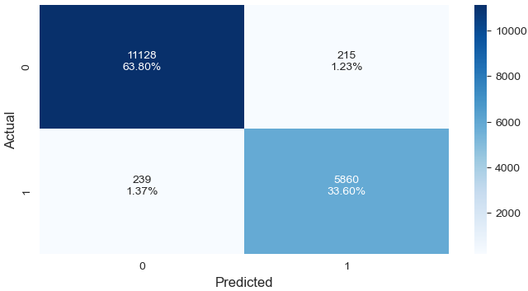
Final Model Tuning: XGBoost
Hyperparameter Tuning
learning_rate
n_estimators
max_depth
Final Training & Testing:
Training + Validation Sets
Test Set
Confusion Matrix

Slide 10

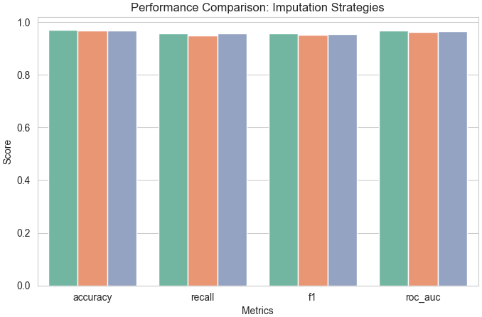

Results
Metrics Used:
accuracy
recall
f1-Score
roc-auc score
Unimputed dataset performs better.
Best Model: XGBoost

Slide 11
Conclusion & Future Scope
Strategy for handling -1 values was crucial for our task.
Handling -1 as invalid value didn’t prove to be ideal.
Counterintuitive strategy of treating -1 resulted in better results.
For future improvement, could devise column-specific strategies for handling -1 values.

Slide 12
Thank You!

